Slide 1




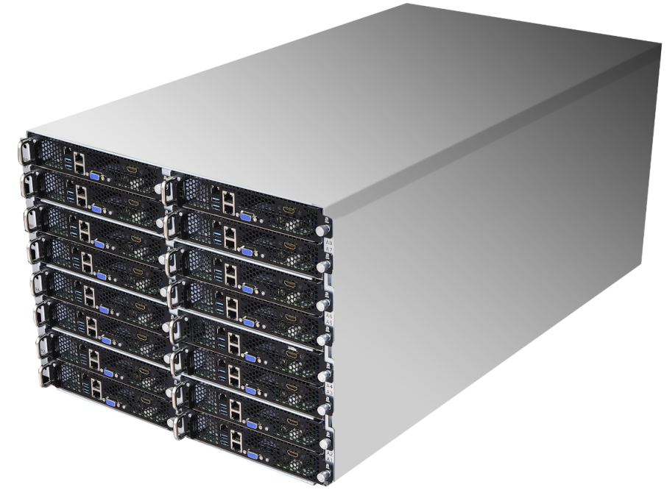
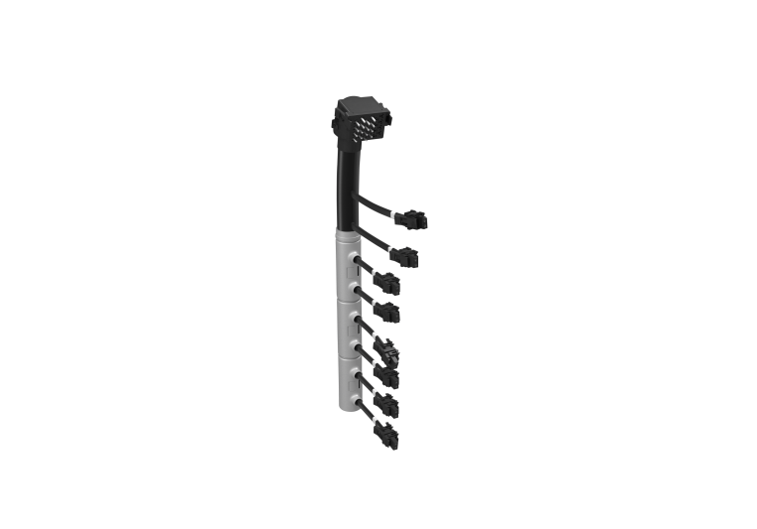
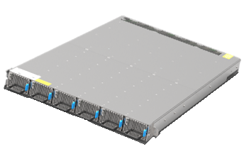
8U16N-X570
8U16N (OPEN19 8RU) Specifications
Physical Status | Form Factor | OPEN19 8RU cage (8 unit high)
 | Dimension (Dx Wx H) | 918.7x 471.5x 355 mm (w/o ear) 918.7x 481.9x 355 mm
 | Brick support | 16 OPEN19 brick
N19 SKU5 (OPEN19 Brick) Barebone Specifications
System Physical Status | Form Factor | OPEN19 brick (1/2 wide 1RU)
 | Dimension | 901.7x 212.3x 41.65 mm (Dx Wx H, w/o ear)
 | Motherboard | X570D4I-2T
Processor System | CPU Socket | AM4 PGA 1331, supports 3rd Gen AMD Ryzen™
 | PCH | AMD X570
DIMM | Slot | 4 DDR4 ECC/ SO-DIMM (2DPC) max. 32GB per DIMM
Front Panel IO | Buttons w/LED | UID, Power
 | LAN | 2 RJ45(10GbE) via X550-AT2 1 RJ45(dedicated IPMI) via AST2500
 | USB | 2 Type-A (USB3.2 Gen2)
 | Video | 1 DB15(VGA) via AST2500 1 HDMI/DP from ASRock Radeon™ RX 5700 XT
Expansions | PCIe slot | 1 dual-slot PCIe4.0 x16 ASRock Radeon™ RX 5700 XT pre-installed
Storage | Internal | 1 M-key (PCIex4/SATA) 2 SFF 2.5” SSD bay (PCIex4/ SATA)
System Cooling | Fan | 4 dual-rotor 40x56 mm fans
Management | BMC | ASPEED AST2500
Security | TPM | TPM by accessory
Power
Power shelf max. power | 19.2kW@ 200-240VAC INPUT/ 240-380VDC INPUT 9.6kW@ 100-120VAC INPUT
PSU module | 6x 3200W RPSU, 80-PLUS Titanium
Power shelf cable | 4 (2 to power 8 bricks on the left, 2 to power 8 bricks on the right )
(1) N19 SKU5 8RU cage
8U
(4) Power shelf cable
1U
(16) N19 SKU5 OPEN19 brick
(1) Power shelf w/6 PSU inside

Slide 2
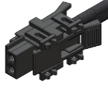
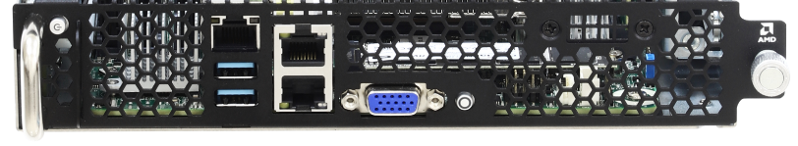
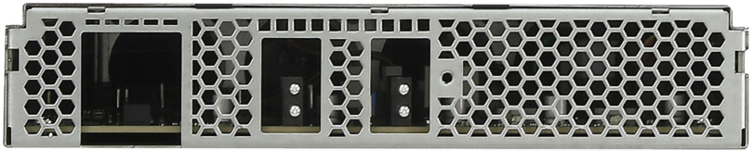
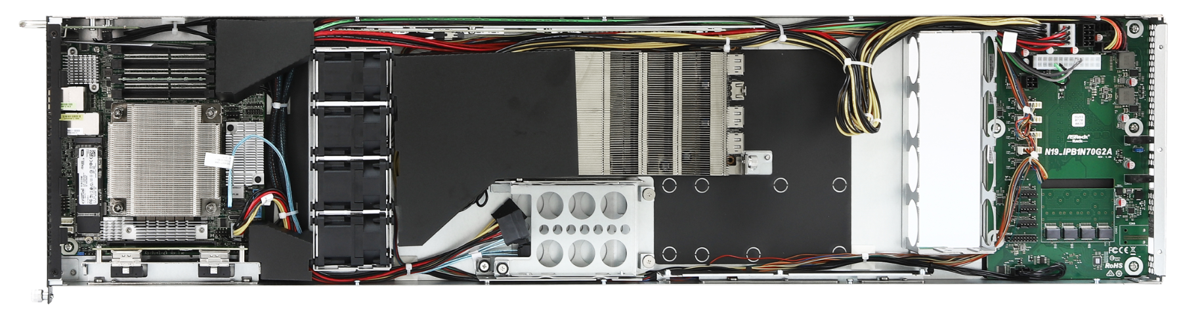
N19 SKU5
Front View
Rear View
Power
button
Dedicated
IPMI
VGA
Optional HDMI/DP output
from graphic card via cable
2x 35A 12V DC-in
2x USB3.2 Gen1
2x 10GbE
RJ45
UID
button
Top View
4x SO-DIMM slots
ASRock Radeon™ RX 5700 XT pre-installed
AM4 socket
M.2 M-key, NGFF 2280 (PCIe x4 or SATA 6Gb/s )
2x 2.5” SSD bay (SATA/ PCIe x4 optional)

