Slide 1
ASRock Rack
1U2FH -4L TEST REPORT
ASRock Rack
16th June ‘16

Slide 2
Content
System components
Thermal solution
Test situation
Test result
Conclusion

Slide 3
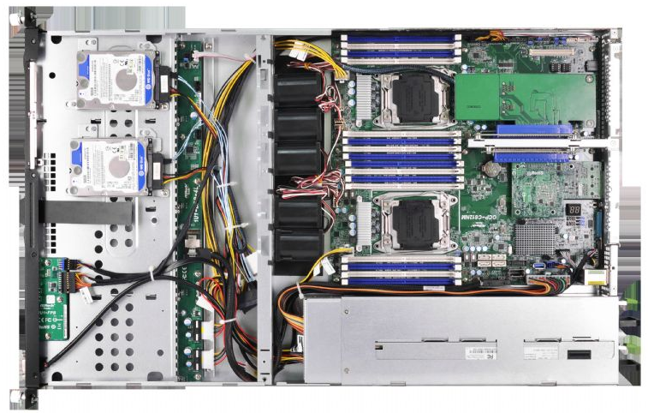
Introduction
DIMM16
HDD_4
FAN5
CPU2
FAN4
HDD_3
FAN3
FAN2
CPU1
FAN1
HDD_2
DIMM1
HDD_1

Slide 4
System components
Name | TDP (W) | Thermal Specification
Intel E5-2690 v3 | 135W | DTS max= 100℃
Memory DDR4 | 3.6W | Tc = 95℃
HDD | 10W | Tc = 55℃
Intel X540 | 12.5W | Tj = 110℃

Slide 5
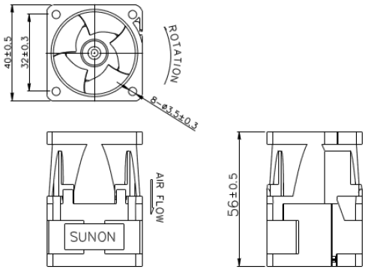
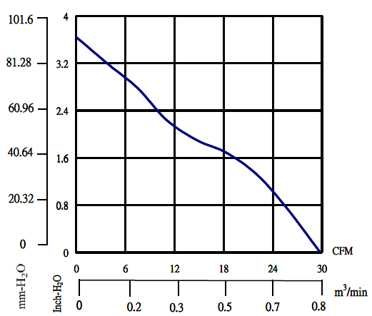
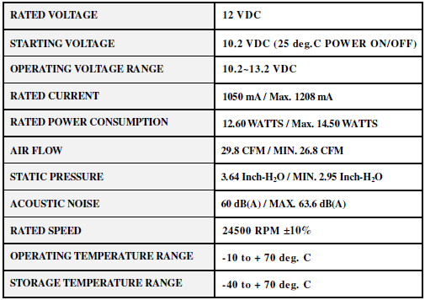
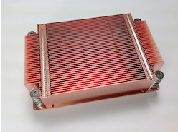
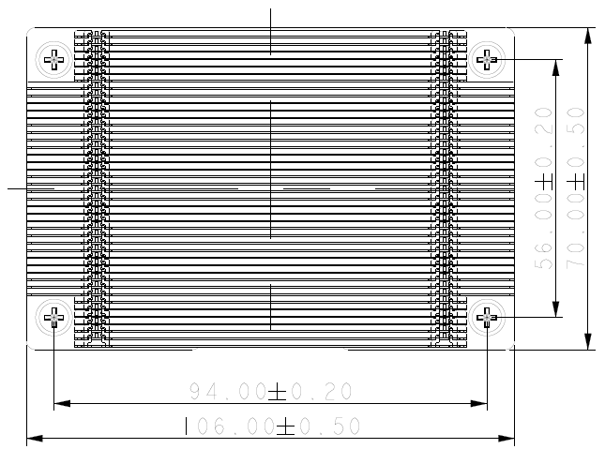
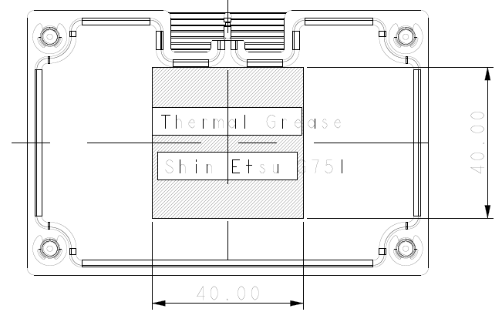
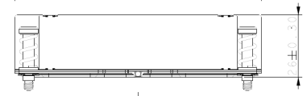
Thermal solution
Thermal Solution | Specification
System Fan
CPU H/S

Slide 6
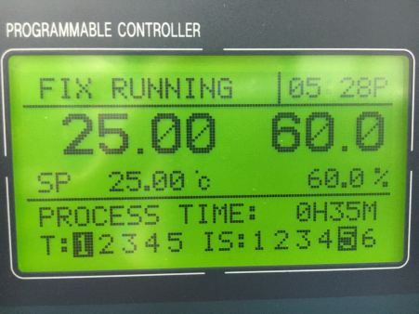
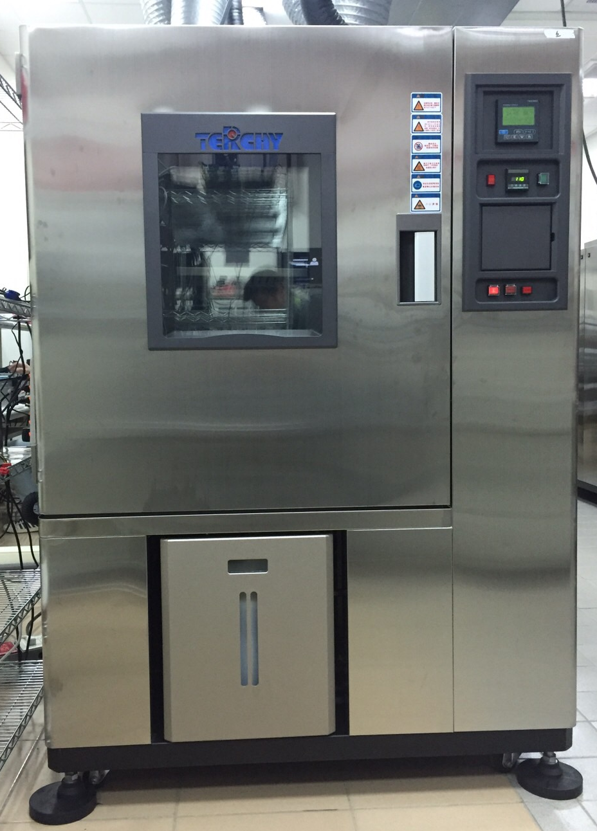
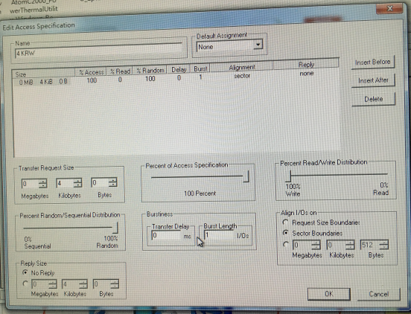
Test situation (25 °C)
Stress CPU tool: PTU
  CPU workload 100%
Stress HDD tool: IOmeter
  Random 100%, write 100%
Stress M540 card tool: Iperf
  Workload 90%~100%

Slide 7
Test result-Stress tool use PTU, Iometer and IPerf
component temp(℃) | Test data | SPEC | Pass/fail
CPU1(Sensor) | 77 | 100 | Pass
CPU2(Sensor) | 72 | 100 | Pass
Dimm(Tc. The highest) | 43 | 95 | Pass
HDD(Tc. The highest) | 29 | 55 | Pass
Intel X540 | 45 | 110 | Pass
Fan | rpm
Fan1 | 16500rpm
Fan2 | 16600rpm
Fan3 | 16500rpm
Fan4 | 19000rpm
Fan5 | 18900rpm

Slide 8
Test result-Stress tool use PTU and Iometer
component temp(℃) | Test data | SPEC | Pass/fail
CPU1(Sensor) | 78 | 100 | Pass
CPU2(Sensor) | 72 | 100 | Pass
Dimm(Tc. The highest) | 43 | 95 | Pass
HDD(Tc. The highest) | 28.9 | 55 | Pass
Intel X540 | 44 | 110 | Pass
Fan | rpm
Fan1 | 17800rpm
Fan2 | 17900rpm
Fan3 | 17900rpm
Fan4 | 20200rpm
Fan5 | 20200rpm

Slide 9
Test result-Stress tool use Iometer
component temp(℃) | Test data | SPEC | Pass/fail
CPU1(Sensor) | 41 | 100 | Pass
CPU2(Sensor) | 37 | 100 | Pass
Dimm(Tc. The highest) | 32 | 95 | Pass
HDD(Tc. The highest) | 30.3 | 55 | Pass
Intel X540 | 56 | 110 | Pass
Fan | rpm
Fan1 | 7000rpm
Fan2 | 7100rpm
Fan3 | 7000rpm
Fan4 | 7000rpm
Fan5 | 7000rpm

Slide 10
Test result-Stress tool use PTU
component temp(℃) | Test data | SPEC | Pass/fail
CPU1(Sensor) | 78 | 100 | Pass
CPU2(Sensor) | 72 | 100 | Pass
Dimm(Tc. The highest) | 42 | 95 | Pass
HDD(Tc. The highest) | 28.7 | 55 | Pass
Intel X540 | 44 | 110 | Pass
Fan | rpm
Fan1 | 17800rpm
Fan2 | 17900rpm
Fan3 | 17800rpm
Fan4 | 20200rpm
Fan5 | 20200rpm

Slide 11
Test result-Stress tool use IPerf
component temp(℃) | Test data | SPEC | Pass/fail
CPU1(Sensor) | 51 | 100 | Pass
CPU2(Sensor) | 50 | 100 | Pass
Dimm(Tc. The highest) | 36 | 95 | Pass
HDD(Tc. The highest) | 30.1 | 55 | Pass
Intel X540 | 56 | 110 | Pass
Fan | rpm
Fan1 | 7000rpm
Fan2 | 7000rpm
Fan3 | 7000rpm
Fan4 | 7600rpm
Fan5 | 7800rpm

Slide 12
Test result-Idel
component temp(℃) | Test data | SPEC | Pass/fail
CPU1(Sensor) | 41 | 100 | Pass
CPU2(Sensor) | 37 | 100 | Pass
Dimm(Tc. The highest) | 32 | 95 | Pass
HDD(Tc. The highest) | 30.8 | 55 | Pass
Intel X540 | 57 | 110 | Pass
Fan | rpm
Fan1 | 7000rpm
Fan2 | 7000rpm
Fan3 | 7000rpm
Fan4 | 7000rpm
Fan5 | 7000rpm

Slide 13
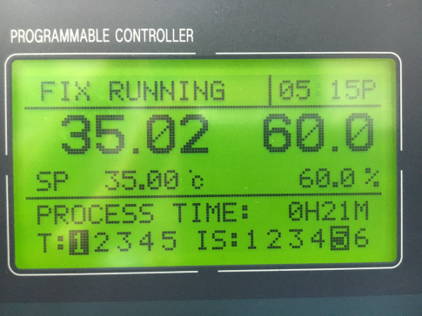
Test situation(35 °C)
Stress CPU tool: PTU
  CPU workload 100%
Stress HDD tool: IOmeter
  Random 100%, write 100%
Stress M540 card tool: Iperf
  Workload 90%~100%

Slide 14
Test result-Stress tool use PTU, Iometer and IPerf
component temp(℃) | Test data | SPEC | Pass/fail
CPU1(Sensor) | 86 | 100 | Pass
CPU2(Sensor) | 80 | 100 | Pass
Dimm(Tc. The highest) | 52 | 95 | Pass
HDD(Tc. The highest) | 38.8 | 55 | Pass
Intel X540 | 55 | 110 | Pass
Fan | rpm
Fan1 | 20200rpm
Fan2 | 20300rpm
Fan3 | 20300rpm
Fan4 | 21500rpm
Fan5 | 21600rpm

Slide 15
Test result-Stress tool use PTU and Iometer
component temp(℃) | Test data | SPEC | Pass/fail
CPU1(Sensor) | 86 | 100 | Pass
CPU2(Sensor) | 80 | 100 | Pass
Dimm(Tc. The highest) | 52 | 95 | Pass
HDD(Tc. The highest) | 39.2 | 55 | Pass
Intel X540 | 54 | 110 | Pass
Fan | rpm
Fan1 | 20300rpm
Fan2 | 20300rpm
Fan3 | 20300rpm
Fan4 | 21500rpm
Fan5 | 21600rpm

Slide 16
Test result-Stress tool use Iometer
component temp(℃) | Test data | SPEC | Pass/fail
CPU1(Sensor) | 50 | 100 | Pass
CPU2(Sensor) | 49 | 100 | Pass
Dimm(Tc. The highest) | 41 | 95 | Pass
HDD(Tc. The highest) | 39.8 | 55 | Pass
Intel X540 | 67 | 110 | Pass
Fan | rpm
Fan1 | 7000rpm
Fan2 | 7100rpm
Fan3 | 7100rpm
Fan4 | 7100rpm
Fan5 | 7000rpm

Slide 17
Test result-Stress tool use PTU
component temp(℃) | Test data | SPEC | Pass/fail
CPU1(Sensor) | 86 | 100 | Pass
CPU2(Sensor) | 80 | 100 | Pass
Dimm(Tc. The highest) | 52 | 95 | Pass
HDD(Tc. The highest) | 38.6 | 55 | Pass
Intel X540 | 53 | 110 | Pass
Fan | rpm
Fan1 | 20300rpm
Fan2 | 20300rpm
Fan3 | 20300rpm
Fan4 | 21500rpm
Fan5 | 21600rpm

Slide 18
Test result-Stress tool use IPerf
component temp(℃) | Test data | SPEC | Pass/fail
CPU1(Sensor) | 53 | 100 | Pass
CPU2(Sensor) | 51 | 100 | Pass
Dimm(Tc. The highest) | 43 | 95 | Pass
HDD(Tc. The highest) | 38.1 | 55 | Pass
Intel X540 | 57 | 110 | Pass
Fan | rpm
Fan1 | 13100rpm
Fan2 | 13100rpm
Fan3 | 13100rpm
Fan4 | 13100rpm
Fan5 | 13100rpm

Slide 19
Test result-Idel
component temp(℃) | Test data | SPEC | Pass/fail
CPU1(Sensor) | 51 | 100 | Pass
CPU2(Sensor) | 49 | 100 | Pass
Dimm(Tc. The highest) | 40 | 95 | Pass
HDD(Tc. The highest) | 39.7 | 55 | Pass
Intel X540 | 67 | 110 | Pass
Fan | rpm
Fan1 | 7100rpm
Fan2 | 7100rpm
Fan3 | 7000rpm
Fan4 | 7100rpm
Fan5 | 7100rpm

Slide 20
Conclusion
In Ta25℃ situation, key components in all test item are pass
In Ta35℃ situation, key components in all test item are pass

